Slide 1


Oracle database
EXERCISES

Slide 2

Today’s Agenda
A Complete Student Database
Exercises

Slide 3
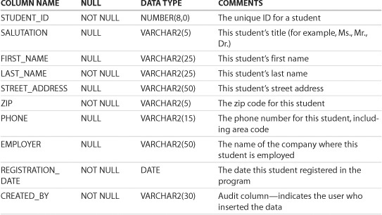
Student Database
STUDENT: Profile Information of a Student

Slide 4
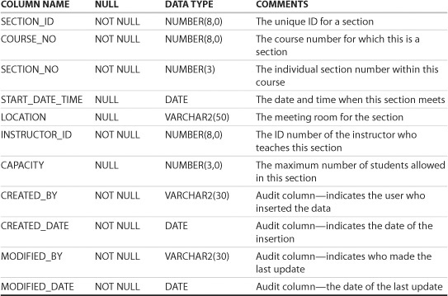
Student Database
SECTION: Information for an individual section (class) of a particular course

Slide 5
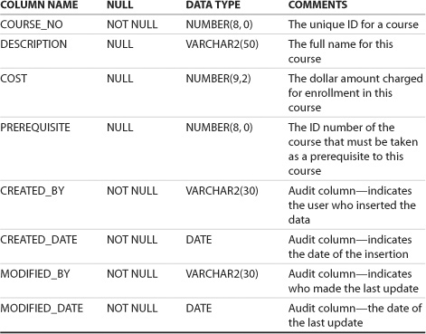
Student Database
COURSE: Information for a course

Slide 6
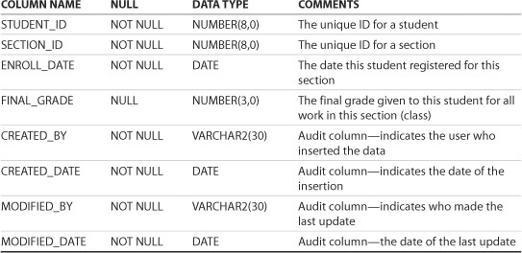
Student Database
ENROLLMENT: Information for a student registered for a particular section (class)

Slide 7
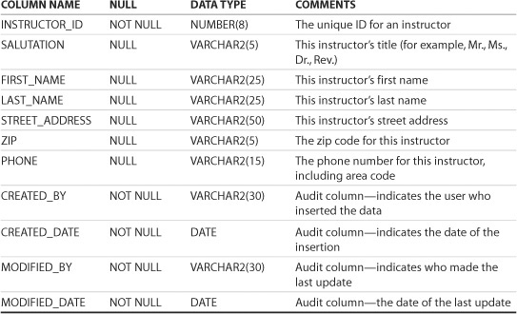
Student Database
INSTRUCTOR: Profile information for an instructor

Slide 8
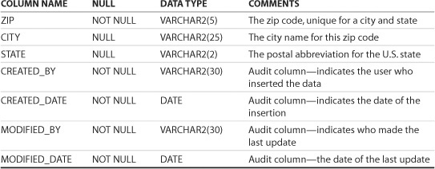
Student Database
ZIPCODE: City, state, and zip code information

Slide 9
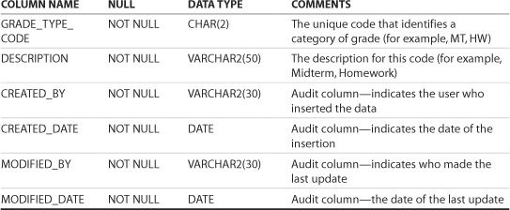
Student Database
GRADE_TYPE: Lookup table of a grade type (code) and its description

Slide 10
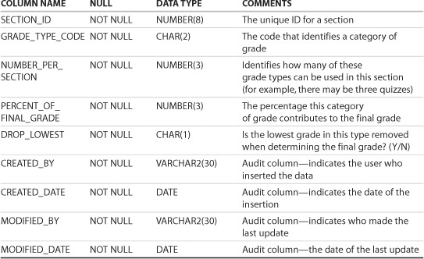
Student Database
GRADE_TYPE_WEIGHT: Information on how the final grade for a particular section is computed (for example, the midterm constitutes 50 percent, the quiz 10 percent, and the final examination 40 percent of the final grade).

Slide 11
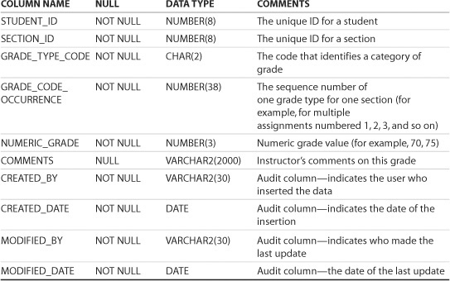
Student Database
GRADE: The individual grades a student received for a particular section (class)

Slide 12
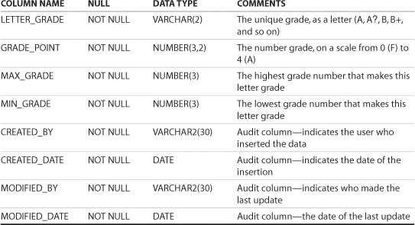
Student Database
GRADE_CONVERSION: Converts a number grade to a letter grade

Slide 13
Queries
WAQ , that determines how many courses do not have a prerequisite.

Slide 14
Queries
WAQ, that determines the total number of students enrolled. Count each student only once, no matter how many courses the student is enrolled in.

Slide 15
Queries
WAQ that determines the date of the most recent enrollment.

Slide 16
Queries
WAQ that shows student IDs and the number of courses each student is enrolled in. Show only those enrolled in more than two classes.

Slide 17
Queries
WAQ, that displays the average room capacity for each course. Display the average, expressed to the nearest whole number, in another column. Use a column alias for each column selected.

Slide 18
Queries
For all students, display last name, city, state, and zip code. Show the result ordered by zip code.

Slide 19
Queries
Select the first and last names of all enrolled students and order by their last name in ascending order.

